Slide 1

Sales Analysis & Actionable Insights for Doubling Company Profits to £19m
Sales Data:
January 2023-October 2025
Adriaan van Heerden PhD (Cantab) FRGS

Slide 2
Contents
01 | Executive Summary
02 | Sales & Seasonality
03 | Profitability Deep Dive
04 | Quality, Returns & Cost
05 | Strategic Levers
06 | Summary & Recommendations
07 | Appendix

Slide 3
01 Executive Summary

Slide 4
Note Regarding Data & Calculations
Note Important Formulas Used in Dataset:
Discount = percentage in decimal form (0.07 = 7% discount)
Revenue = (Price × Quantity) × (1 - Discount)
Cost = per-unit cost
Profit = Revenue × (1 - Cost/Price)
The profit calculation maintains the same profit margin percentage regardless of the discount given to the customer. So if a product has an 80% margin, it keeps that 80% margin even when discounted.
Dataset Range:
First date: 2023-01-01
Last date: 2025-10-31
Date range: 1,034 days
Months covered: 34 months
6,000 orders
Columns in Dataset:
1. Order Date
2. Product ID
3. Product
4. Quantity
5. Price
6. Cost
7. Discount
8. Revenue
9. Profit
10. Delivery Time (Days)
11. Returned
12. Customer Name
13. Region

Slide 5
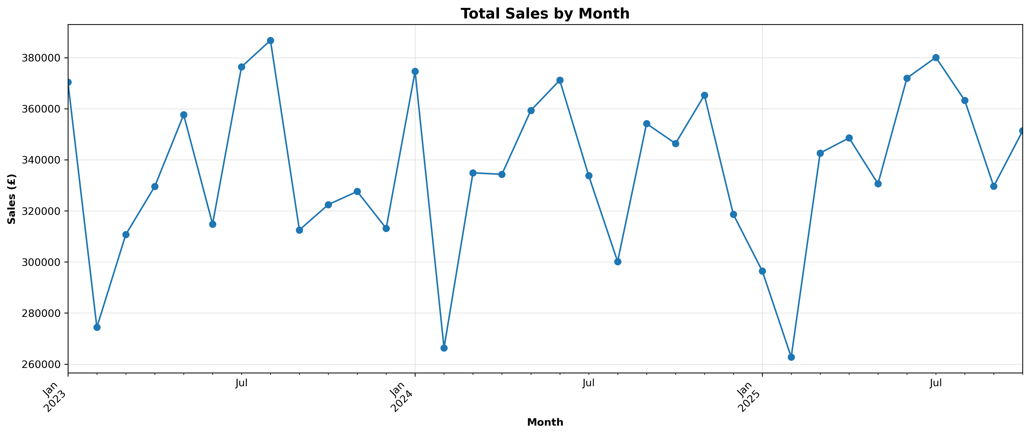
Metric | Value
Total Revenue | £11,432,426.50
Total Profit | £9,352,014.30
Profit Margin | 81.8% (cost base may need review)
Return Rate | 6.9% (industry average = ~5–10% )
Average Delivery Time | 8 days
Top Selling Product | Office Desk (1,901 units)
Most Profitable Product | Wardrobe (£1.9m total profit)
Worst Performing Region | North East (Profit = £1,136,743)
Best Performing Region | South East (Profit = £1,222,525)
Monthly sales follow seasonal pattern
Sales haven’t exceeded peak of Aug 2023
Sales dip in January & February → review marketing
Top 3 Insights | Top 3 Actions to Achieve >100% Profit Increase
We are currently eroding our highest margins by offering discounts on products that do not need them Our business is heavily transactional, leaving millions on the table by failing to retain customers after their first purchase We don't need to expand to new territories to grow; we simply need to replicate our own best practices | Stop discounting unresponsive products Implement Customer Loyalty Programme Marketing campaign targeting London & South East

Slide 6
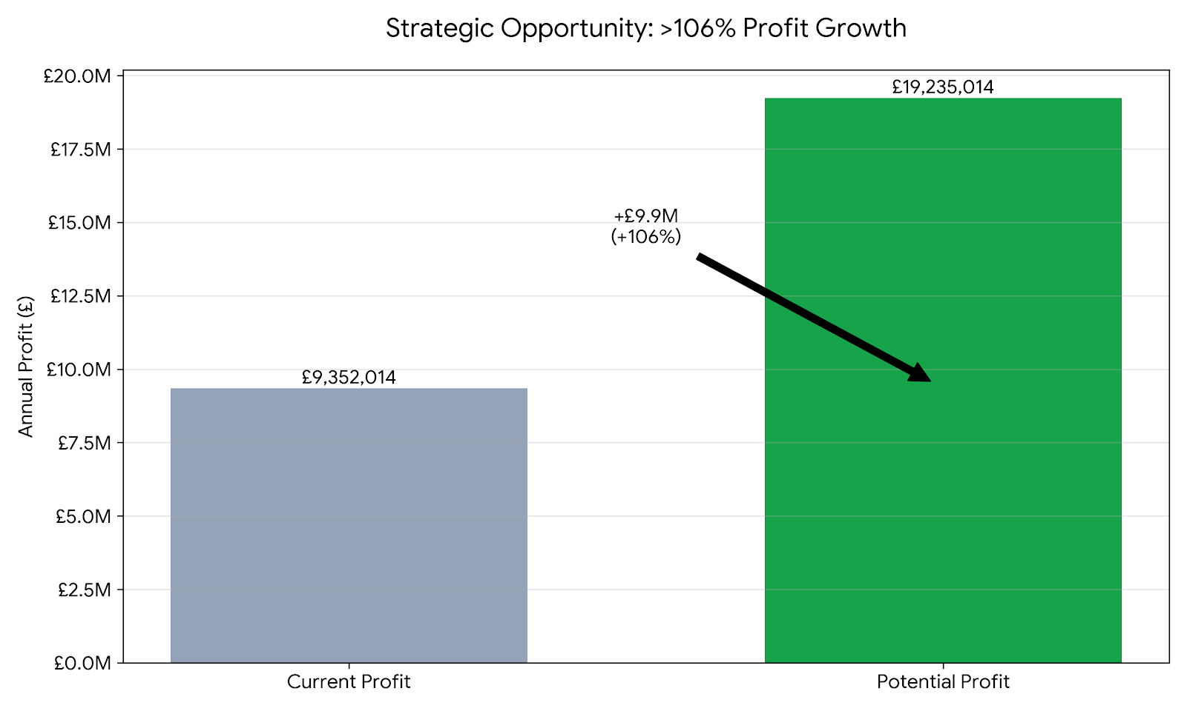
Strategic Profit Opportunity
· Present Value: £9.4m
· Additional Opportunity: +£9.9m
· Projected Value: £19.2m

Slide 7
Actionable Insights for >100% Profit Opportunity
Initial opportunities identified via data analysis; to be validated with corporate functions including Finance, Sales & Marketing

Slide 8
02 Sales & Seasonality

Slide 9
Consistent drop in sales in February → can we market different products in that period/run seasonal promotions?

Slide 10
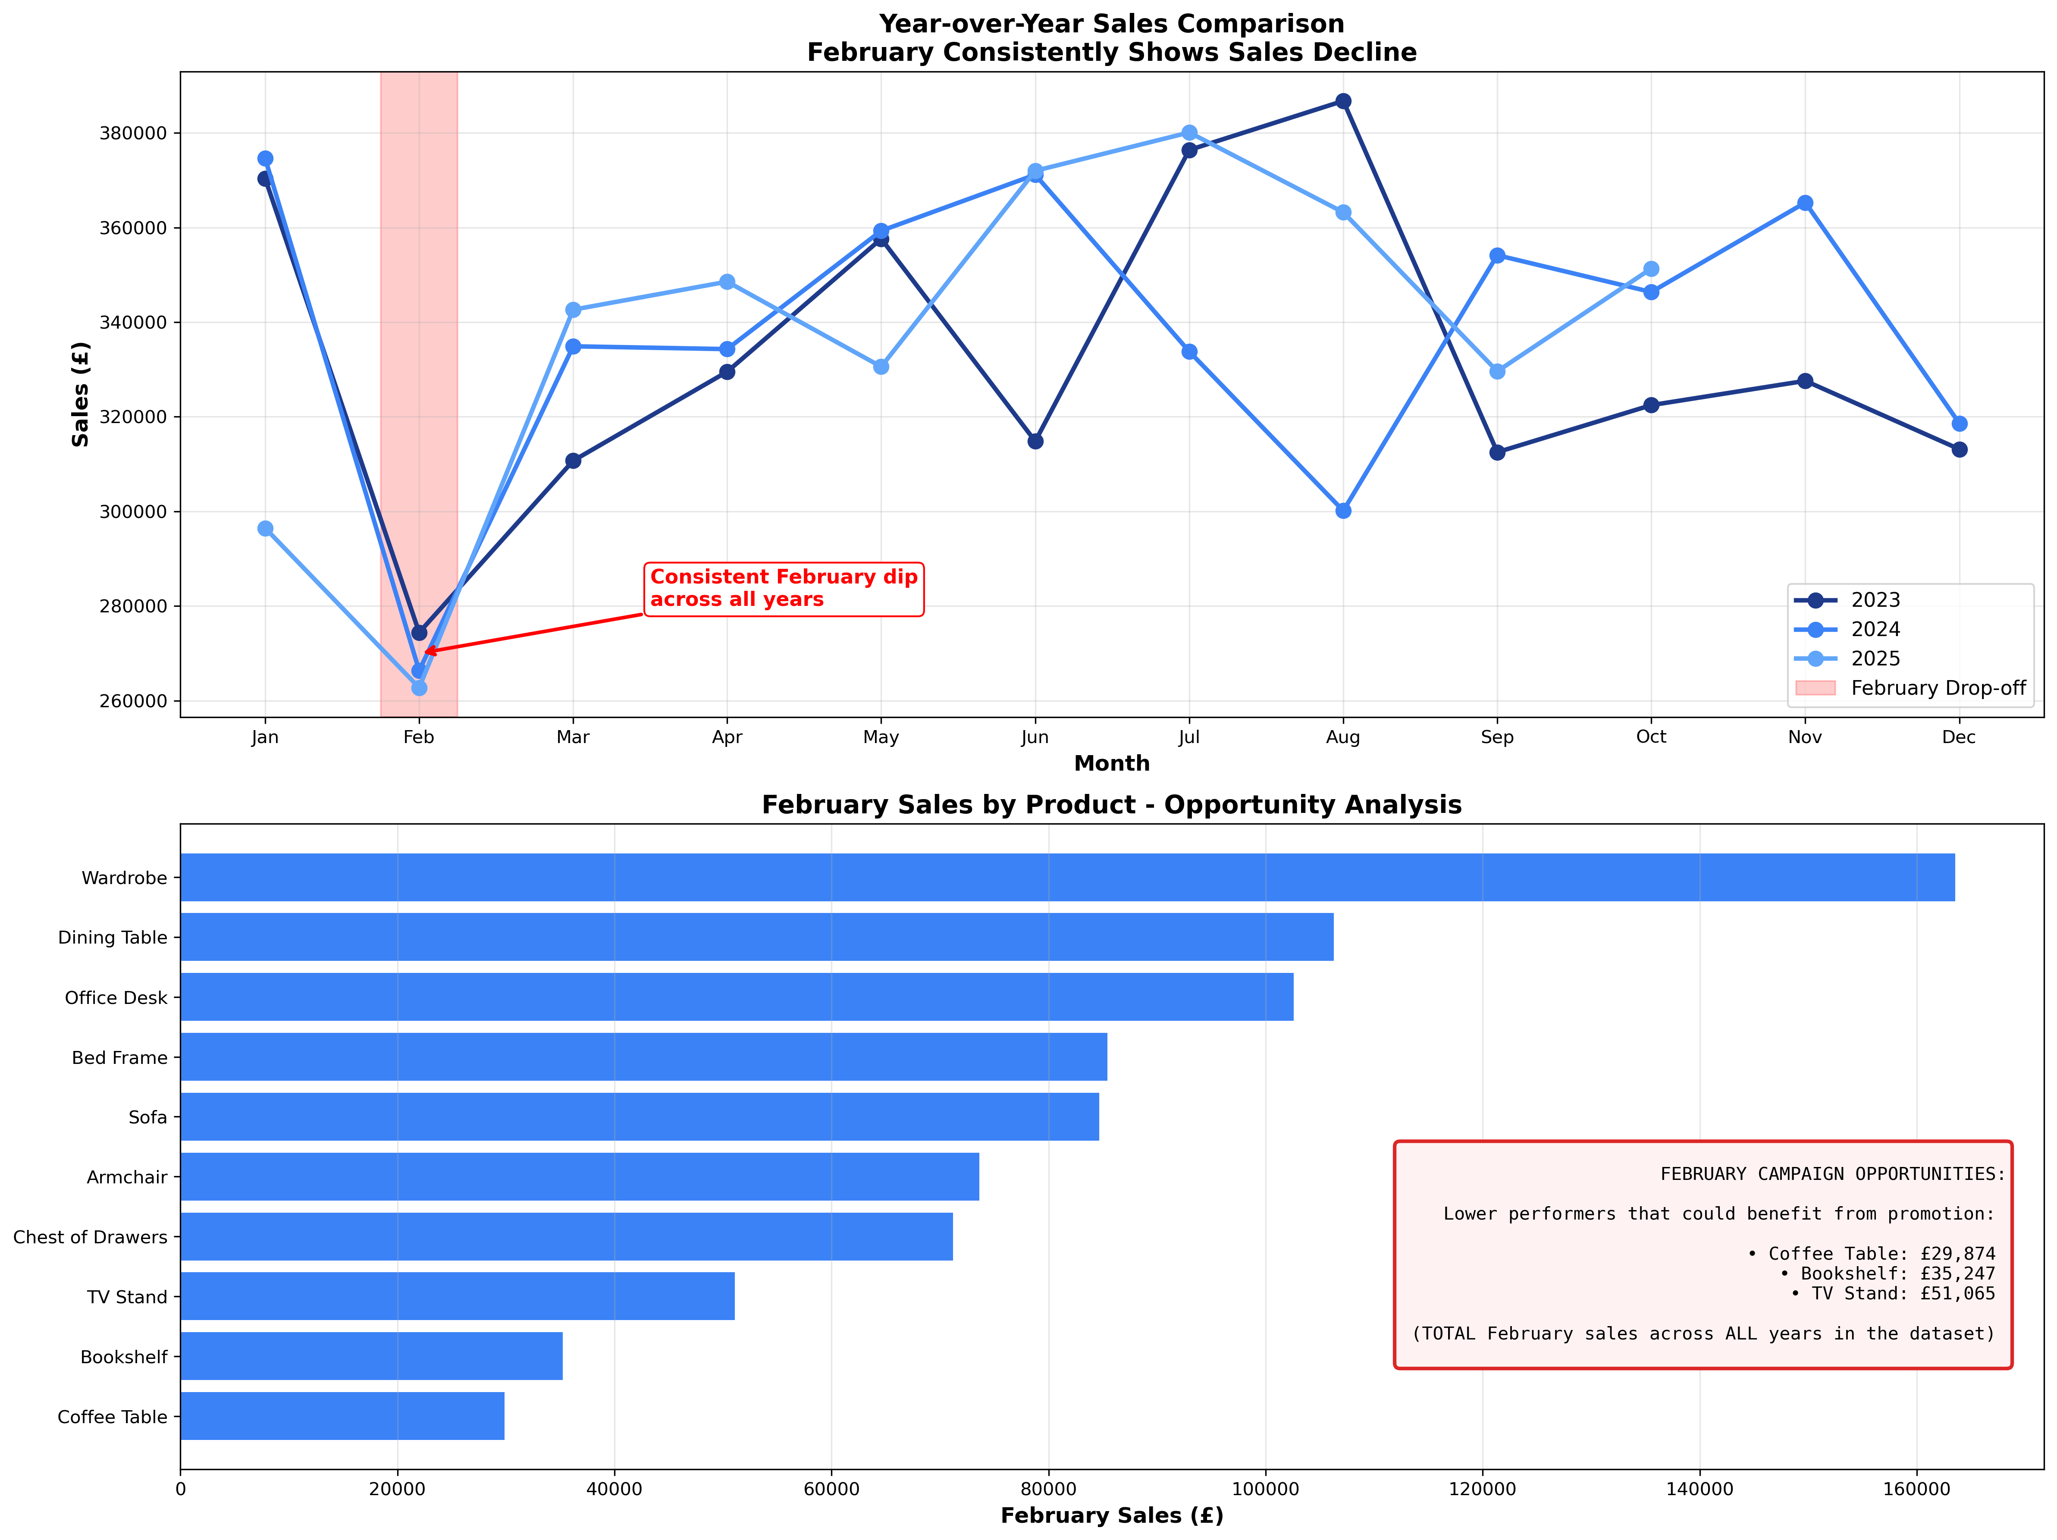
Consistently lower sales in February, combined with drop off in sales in January 2025
Address with root cause analysis & targeted campaigns in lowest selling products

Slide 11
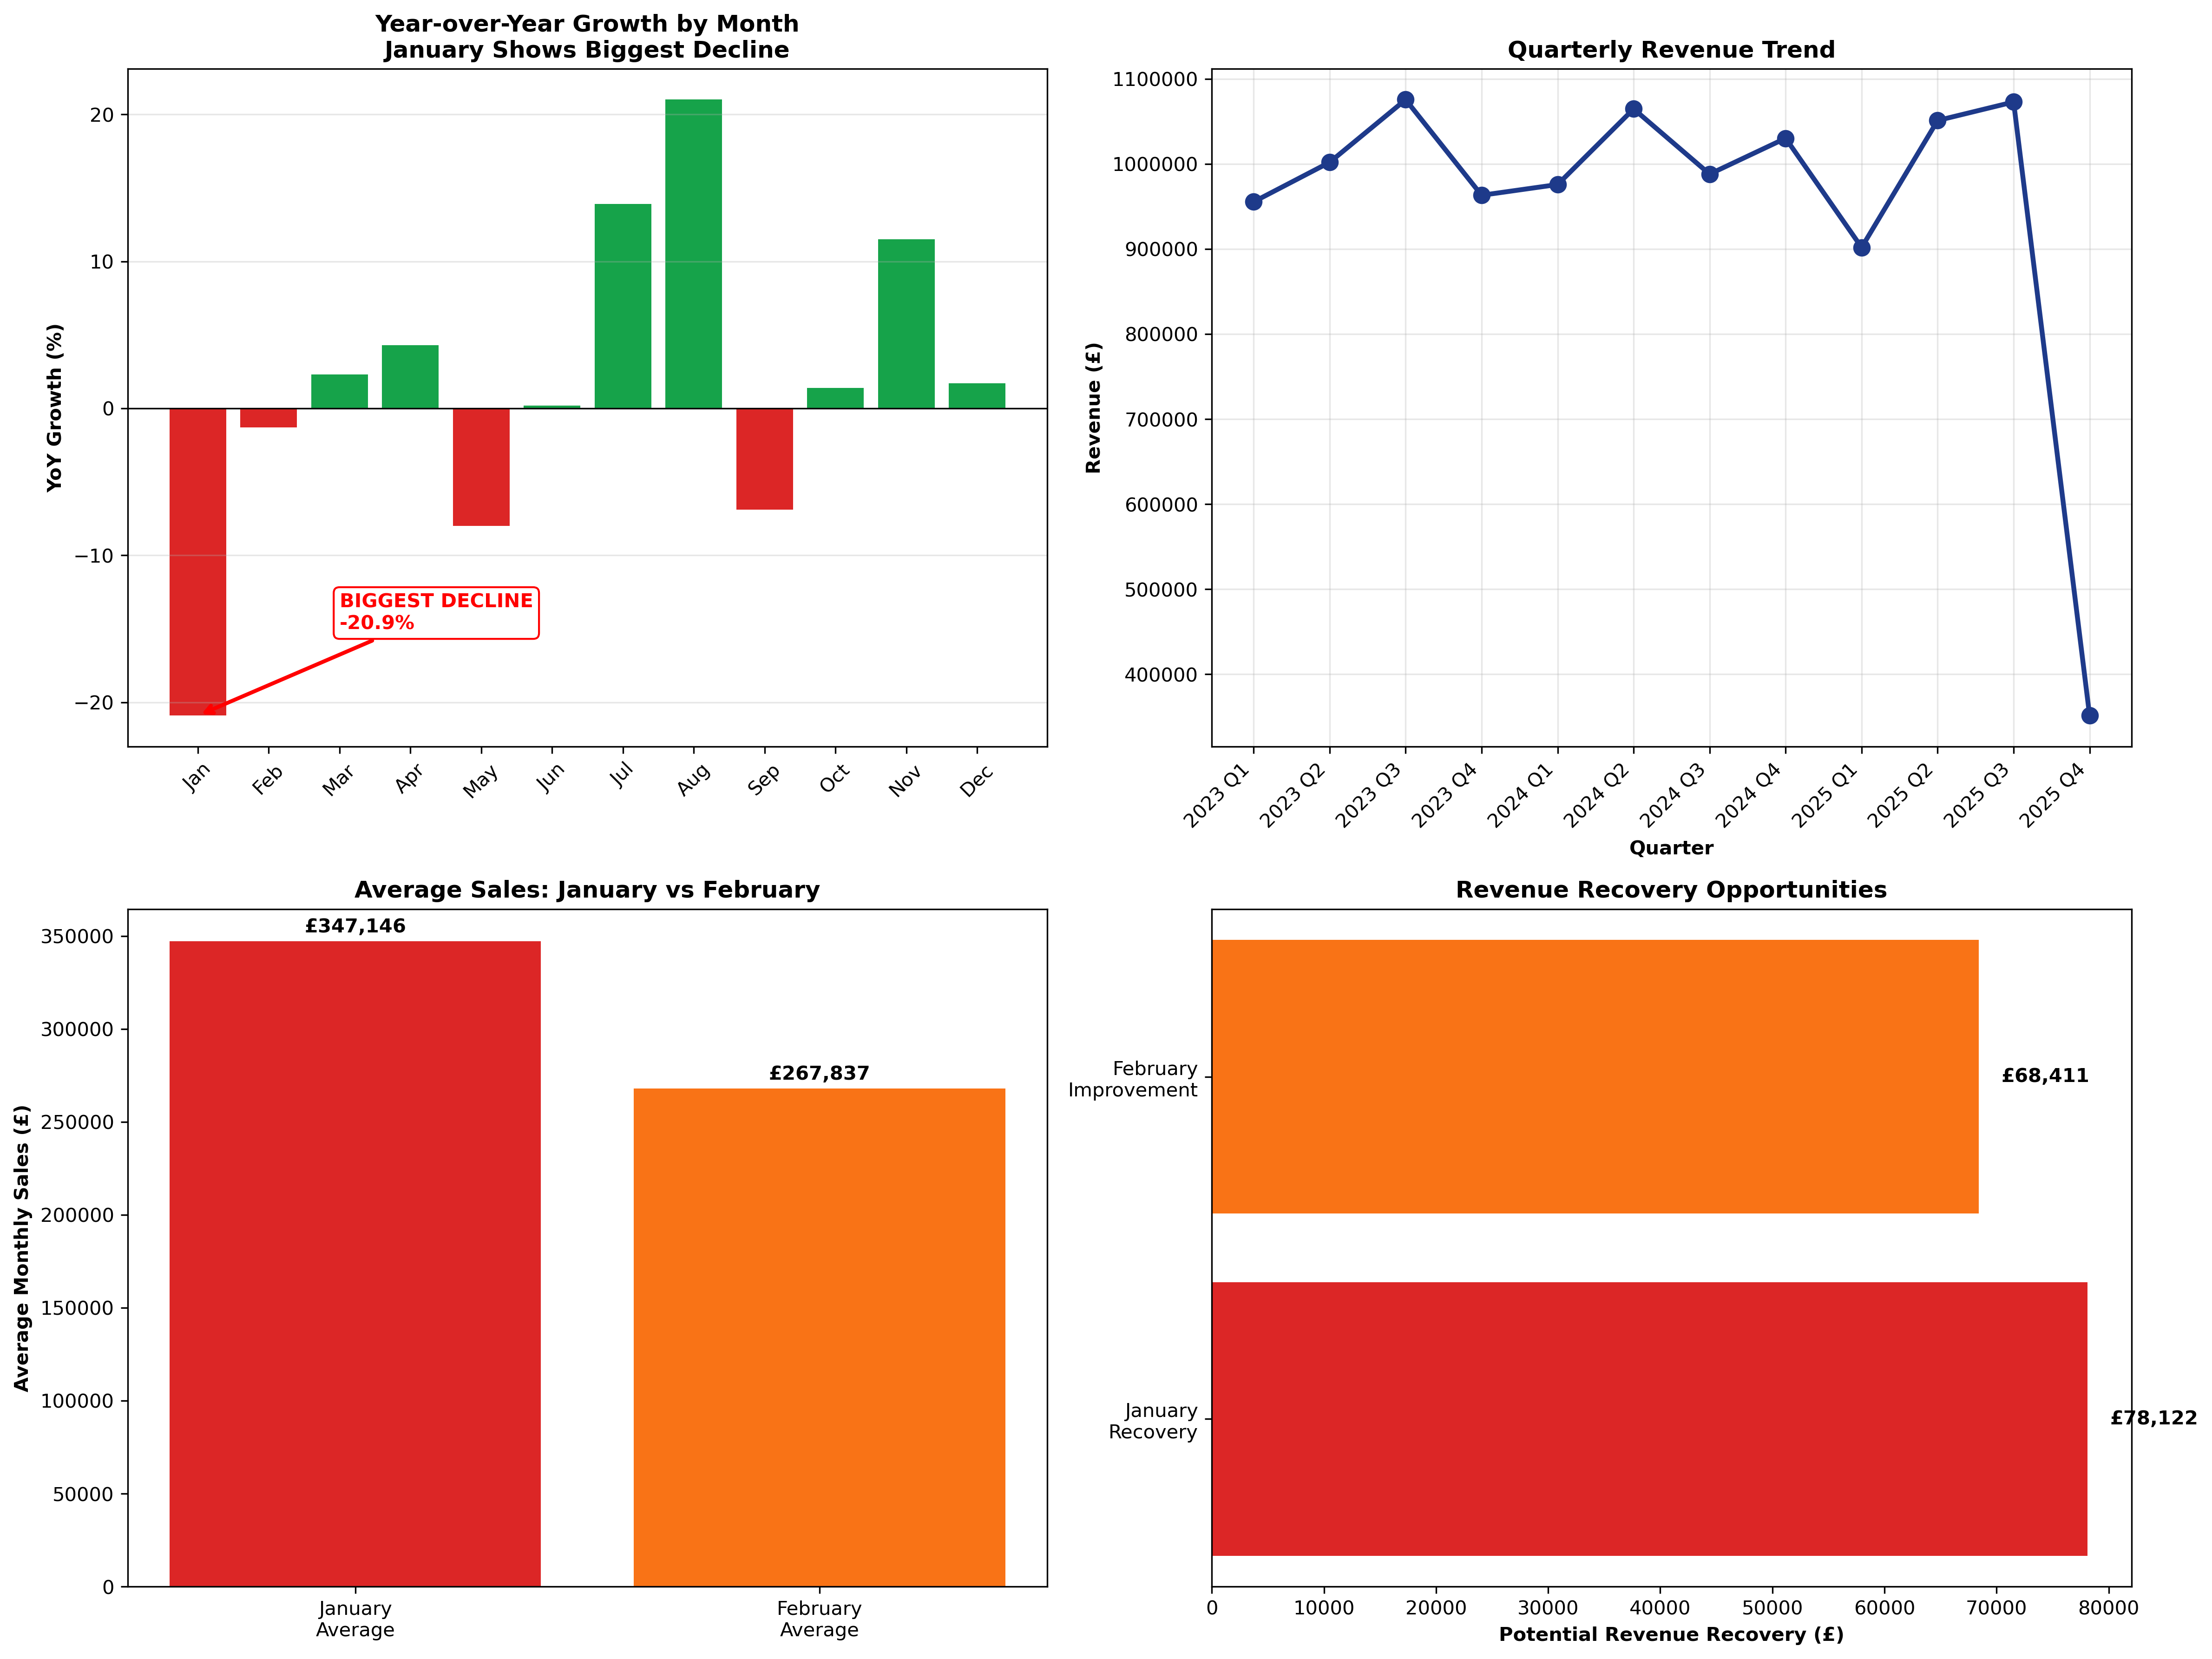
==============================
JANUARY PRODUCT PERFORMANCE –
YEAR-OVER-YEAR
==============================
Products Contributing to January
Decline (Jan 2024 vs Jan 2025):
-------------------------------------------------
Bed Frame: £-39,750 (-54.0%)
Wardrobe: £-31,305 (-36.4%)
Office Desk: £-26,080 (-50.3%)
Armchair: £-8,035 (-27.7%)
TV Stand: £-5,316 (-32.7%)
==============================
JANUARY VS FEBRUARY –
ABSOLUTE COMPARISON
==============================
Average January Sales: £347,146
Average February Sales: £267,837
Difference: £79,310
✓ January is still 29.6% higher than
February on average
✓ But January is declining rapidly
(-20.9% YoY)
✓ February is stable but chronically low

Slide 12
=========================================================
STRATEGIC RECOMMENDATIONS - PRIORITISED
=========================================================
PRIORITY 1: RECOVER JANUARY SALES (URGENT)
━━━━━━━━━━━━━━━━━━━━━━━━━━━━━━
Revenue at Risk: £78,122
Urgency: HIGH - This is a new problem that's getting worse
Recovery Potential: HIGH - We had this revenue last year
━━━━━━━━━━━━━━━━━━━━━━━━━━━━━━
PRIORITY 2: ADDRESS CHRONIC FEBRUARY WEAKNESS (IMPORTANT)
━━━━━━━━━━━━━━━━━━━━━━━━━━━━━━
Chronic Deficit: £68,411 below monthly average
Urgency: MODERATE - Stable but consistently underperforming
Recovery Potential: MODERATE - Structural issue, harder to fix
━━━━━━━━━━━━━━━━━━━━━━━━━
BOTTOM LINE:
━━━━━━━━━━━━━━━━━━━━━━━━━
January is our BIGGEST opportunity: £78,122 in recently lost revenue
February is important but more structural: £68,411 chronic gap
Focus 70% of resources on January, 30% on February
January is easier to fix because we just need to recover what we recently lost
Total Q1 opportunity: £146,533
━━━━━━━━━━━━━━━━━━━━━━━━━

Slide 13
ACTION PLAN FOR JANUARY 2026:
🎯 "New Year, New Workspace" Campaign (Launch Dec 26-Jan 15)
Target products that declined most
Position as "fresh start" for the new year
Early bird discount for orders placed before Jan 10
Target: Recover 50% of loss = £39,061
2. 📧 Win Back Lost January Customers
Identify customers who bought in Jan 2024 but not Jan 2025
Send personalised "We Miss You" campaign
Offer 15% discount code valid Jan 1-31
Target: Recover 30% of loss = £23,436
3. 💰 Post-Holiday Promotion
Many competitors run sales in January
Launch "January Clearance" for slower-moving items
Bundle deals on products that declined most
Target: Recover 20% of loss = £15,624
4. 🔍 Investigate What Changed
Review: Did you stop any marketing campaigns?
Review: Did competitors launch aggressive January promotions?
Review: Were there delivery issues?
Review: Did pricing change?
ACTION PLAN FOR FEBRUARY 2026:
❄️ “Beat the Winter Blues” Campaign
Position products as mood-boosters for dreary February
Focus on lighting, desk accessories, comfortable seating
Target: £20,523
2. ❤️ Valentine's "Workspace Love" Campaign (Feb 10-14)
Gift-friendly items at special pricing
"Treat yourself" messaging
Target: £13,682
3. 🎯 February Flash Sales
Weekly 24-hour flash sales on different products
Create urgency in typically slow month
Target: £13,682

Slide 14
03 Profitability Deep Dive

Slide 15
We sell 10 products, at prices ranging from £200 - £1,500
Most profitable product = Wardrobe
Least profitable product = Coffee Table → raise profit margin to 83%? → potential £9,422 additional profit*
Sofa profit margin = 75 → raise profit margin to 83%? → potential £131,624 additional profit*
* Total potential opportunity = £141,045

Slide 16
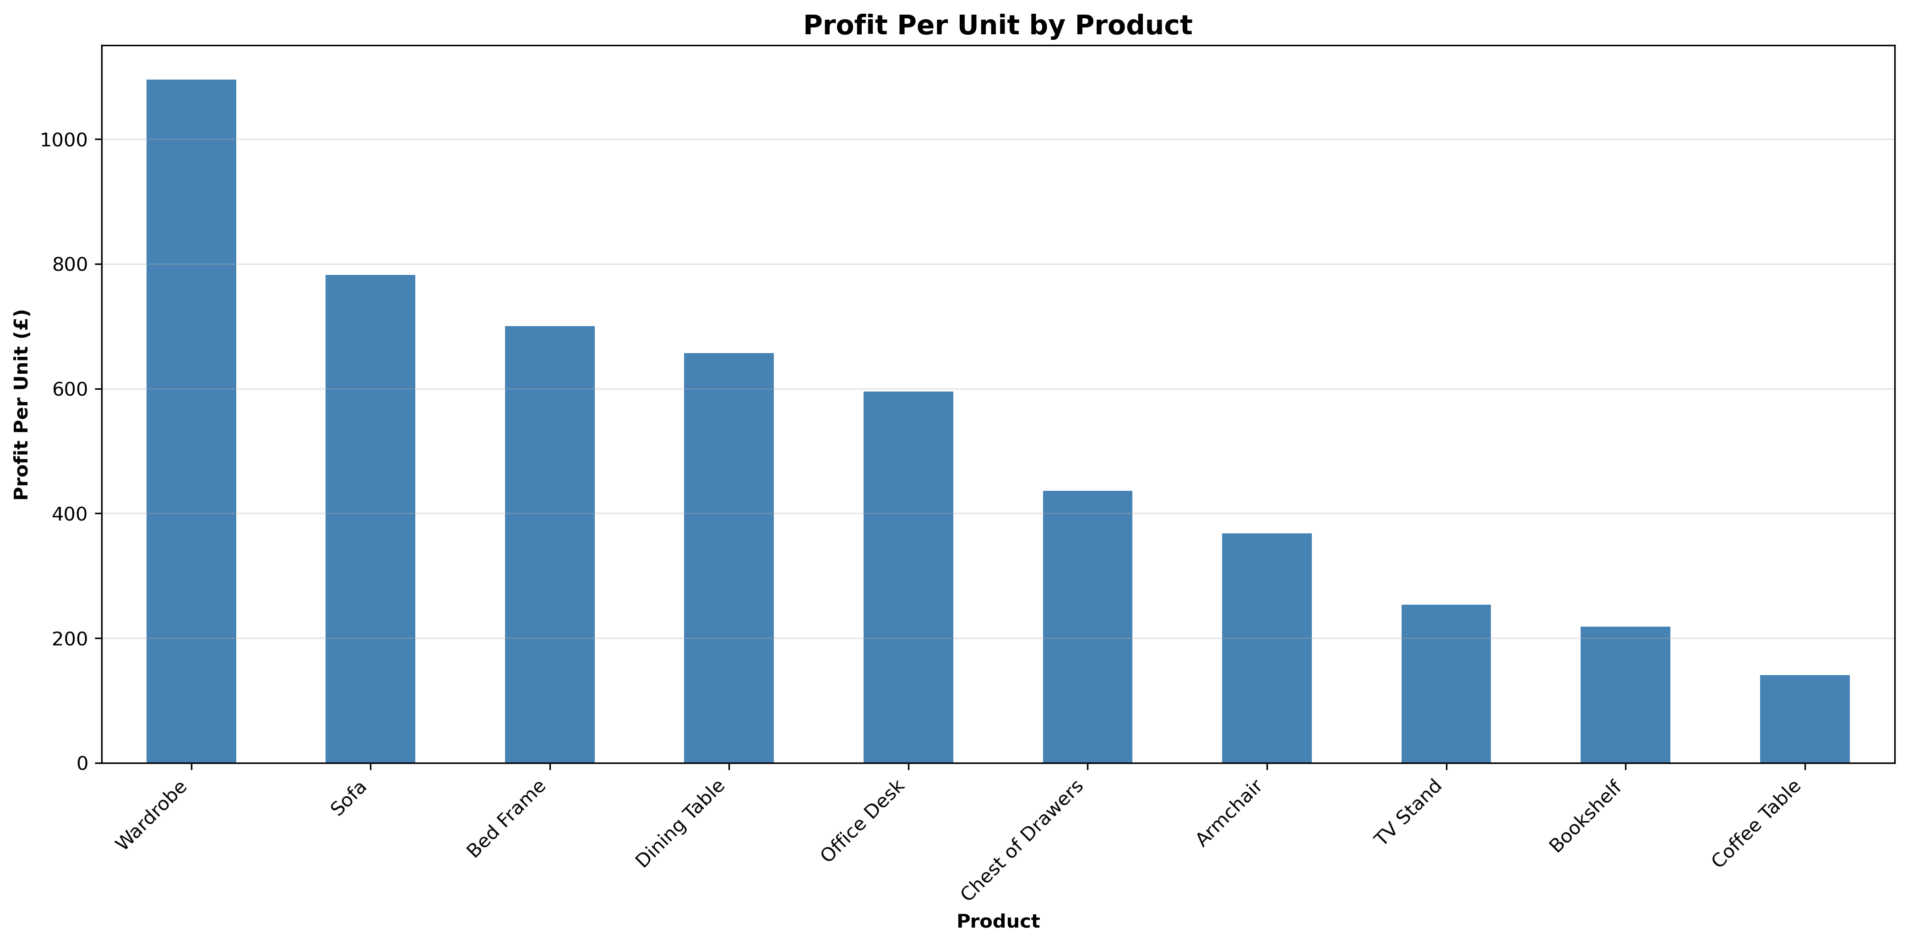
Can the profit margin of these products be increased?

Slide 17
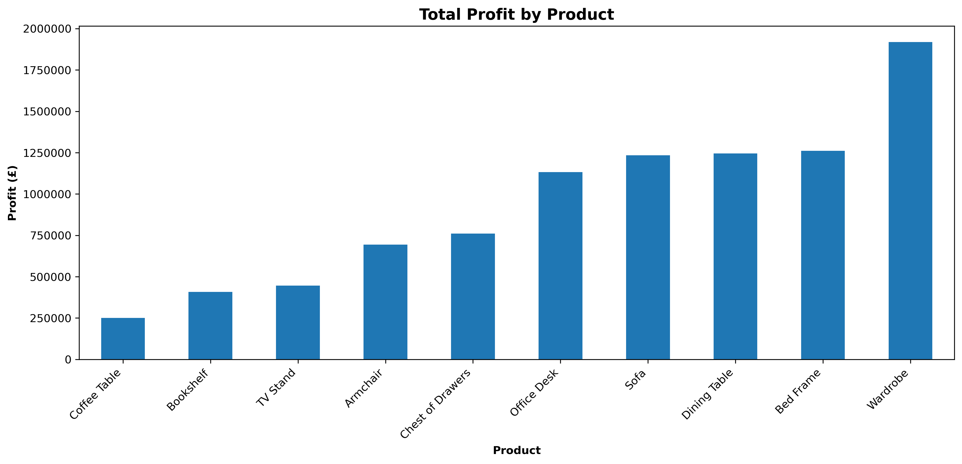
Discontinue & shift production
Or do these items need redesign?

Slide 18
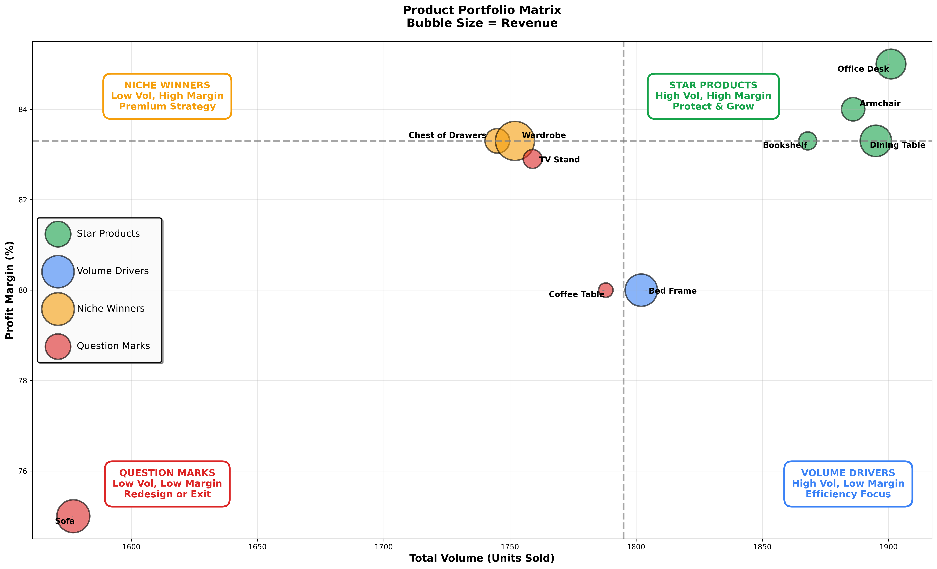
Sofa acts as a "heavy lifter”: we don't sell many, and our efficiency isn't great, but the sheer size of the price tag means it contributes a massive amount to our bottom line.
Recommendation:
Do not simply "Exit" the Sofa as the red box in the matrix suggests. That would wipe out over £1.2m in profit.
Instead, the strategy should be "Redesign":
Investigate Costs: Since the margin is low (75%), our manufacturing or shipping costs for sofas are likely too high.
Repricing: Can we raise the price slightly to improve the margin without killing the volume?

Slide 19
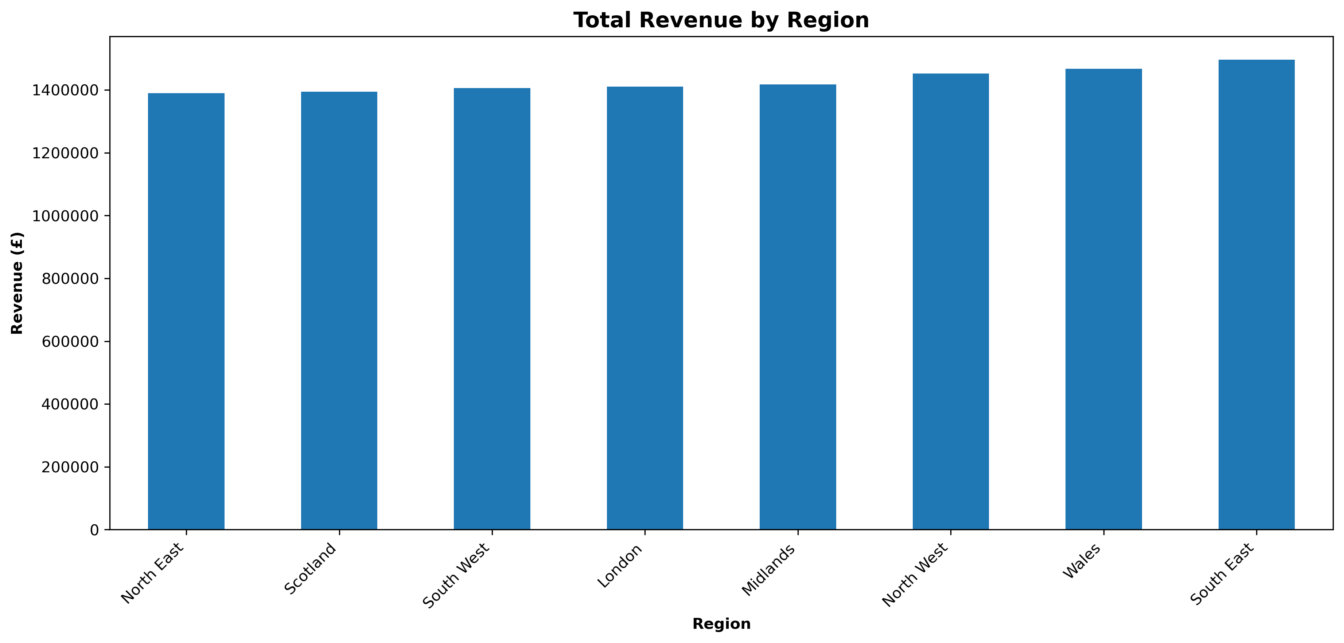
Regions
We operate in 8 regions, covering the whole of England, Wales and Scotland

Slide 20
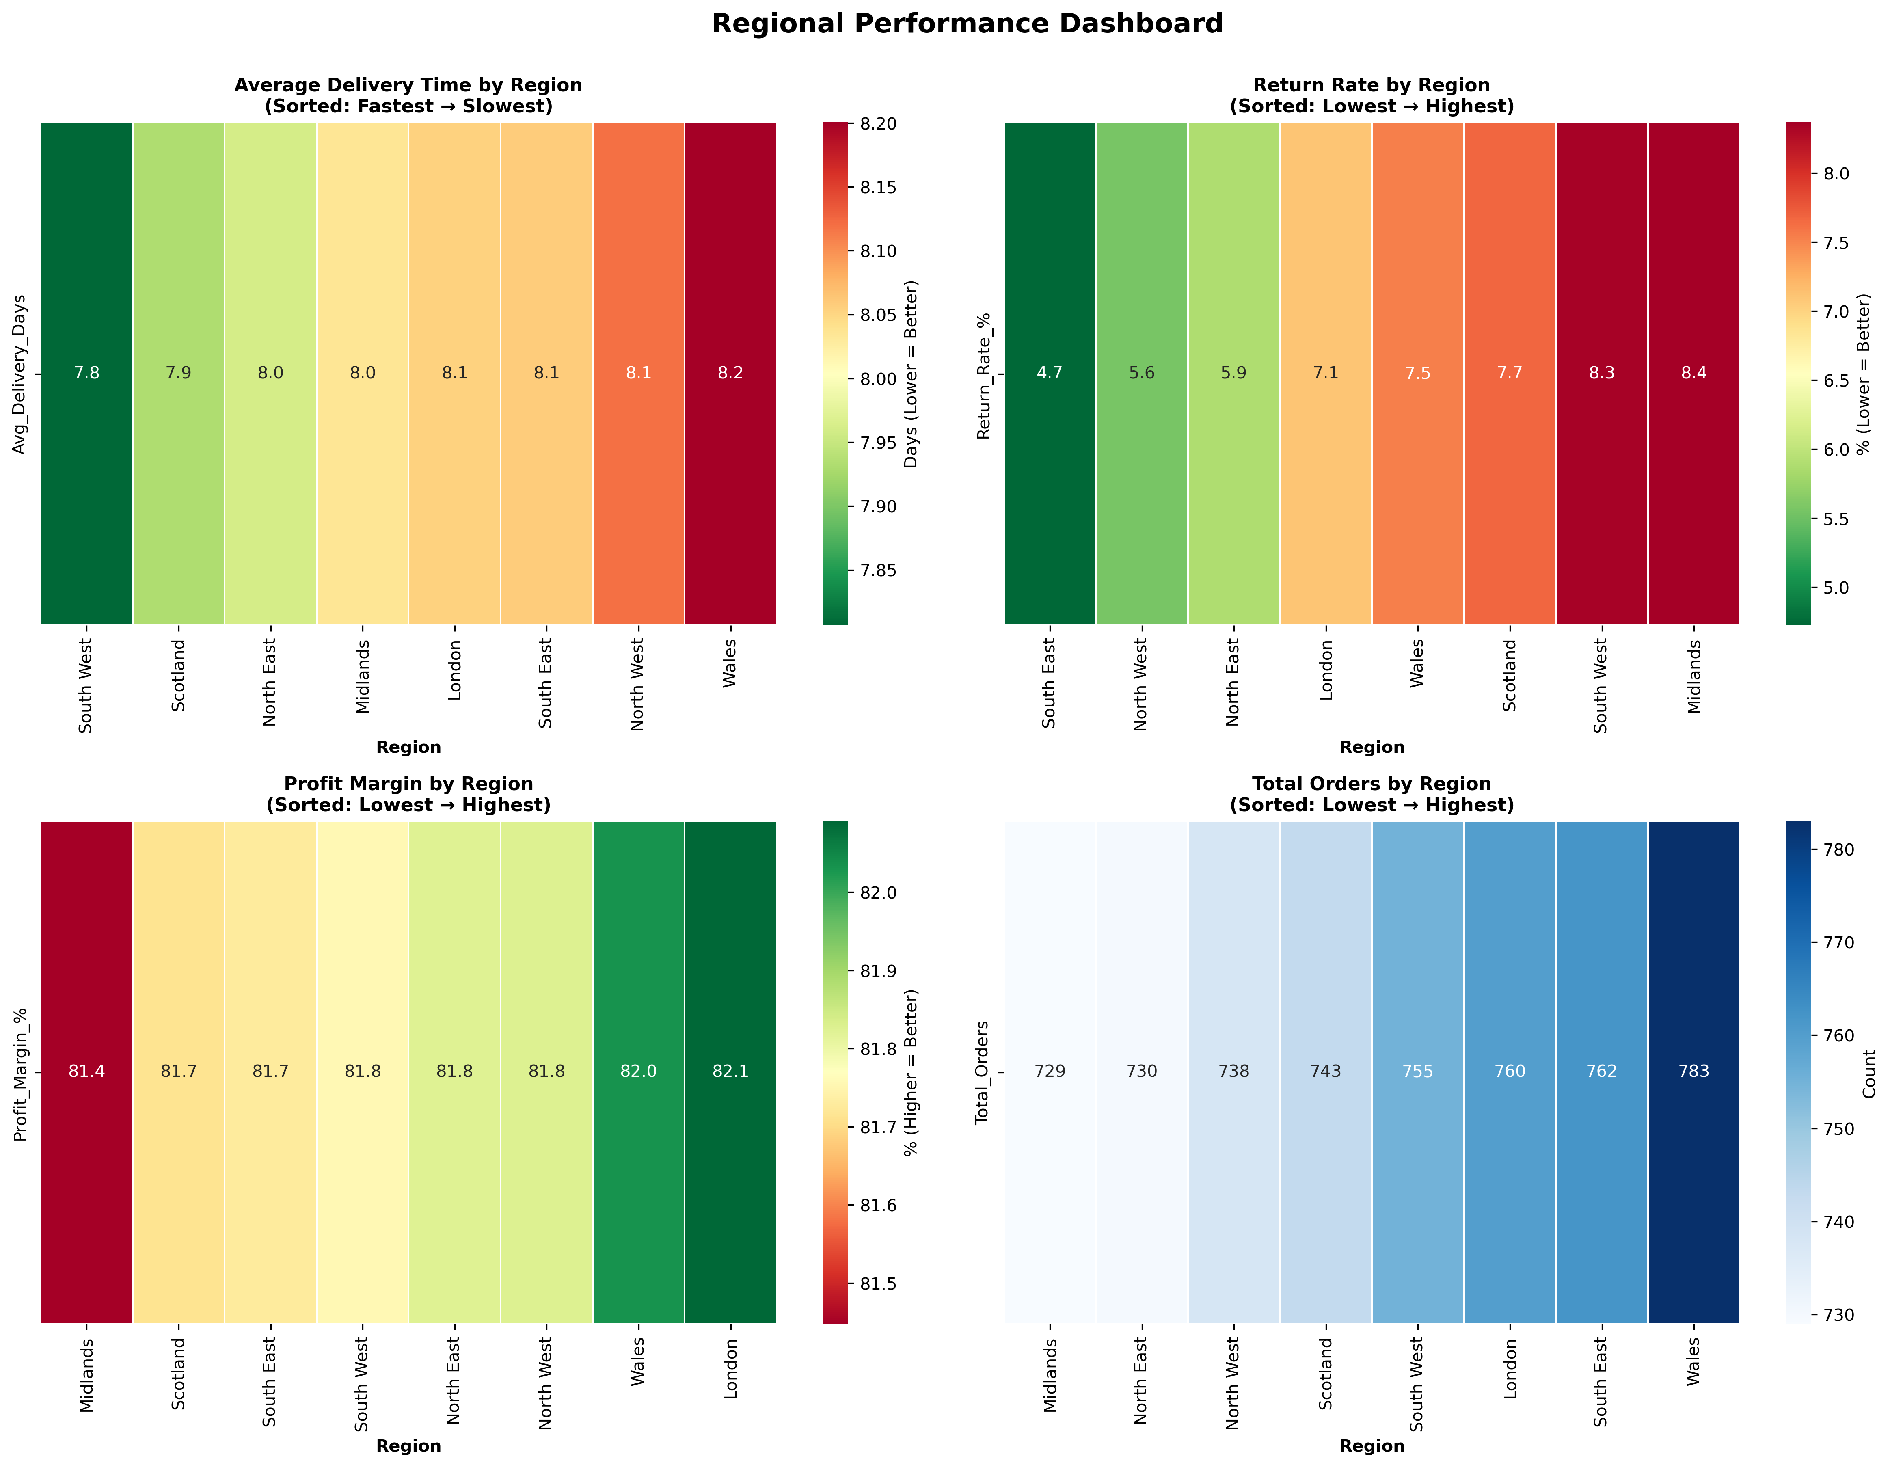
Regional Performance
Actionable Insights:
Immediate: Reduce South West & Midlands Returns
Investigate root causes
Benchmark vs South East (4.7%)
Optimise Wales Delivery
Analyse logistics (8.2 vs 7.8 days)
Strong margins despite delay
Replicate South East Success
Document best practices
Roll out to other regions
Maintain Strengths
Delivery consistency advantage
High margins (>81%)

Slide 21
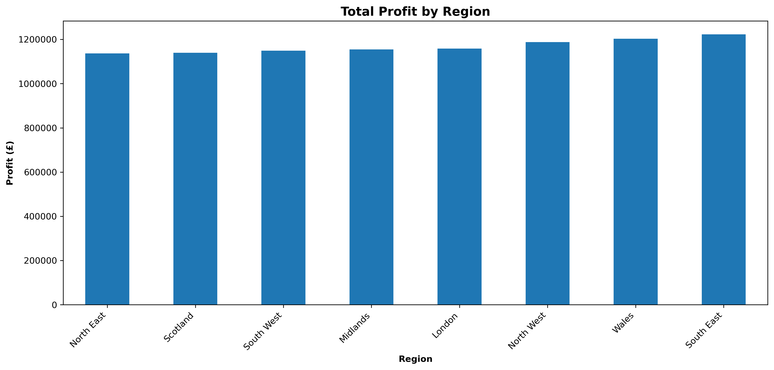
Total pop: 2.8m
Total pop.: 9.6m
8% diff:
NE = £1,136,743
SE = £1,222,525

Slide 22
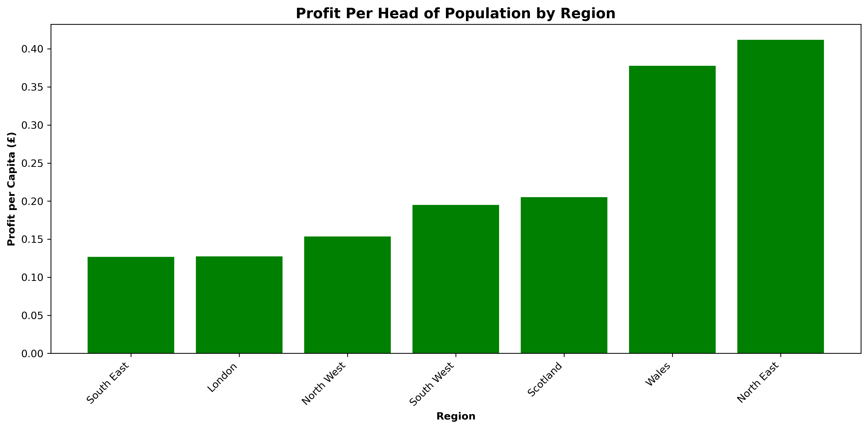
Chart shows that North East is best performing region in terms of per capital profitability, despite lower overall profit. What can we do to raise profit per capital in London & South East?
→ Potential +£5.3m profit impact
https://www.statista.com/statistics/294729/uk-population-by-region/

Slide 23
04 Quality, Returns & Cost

Slide 24
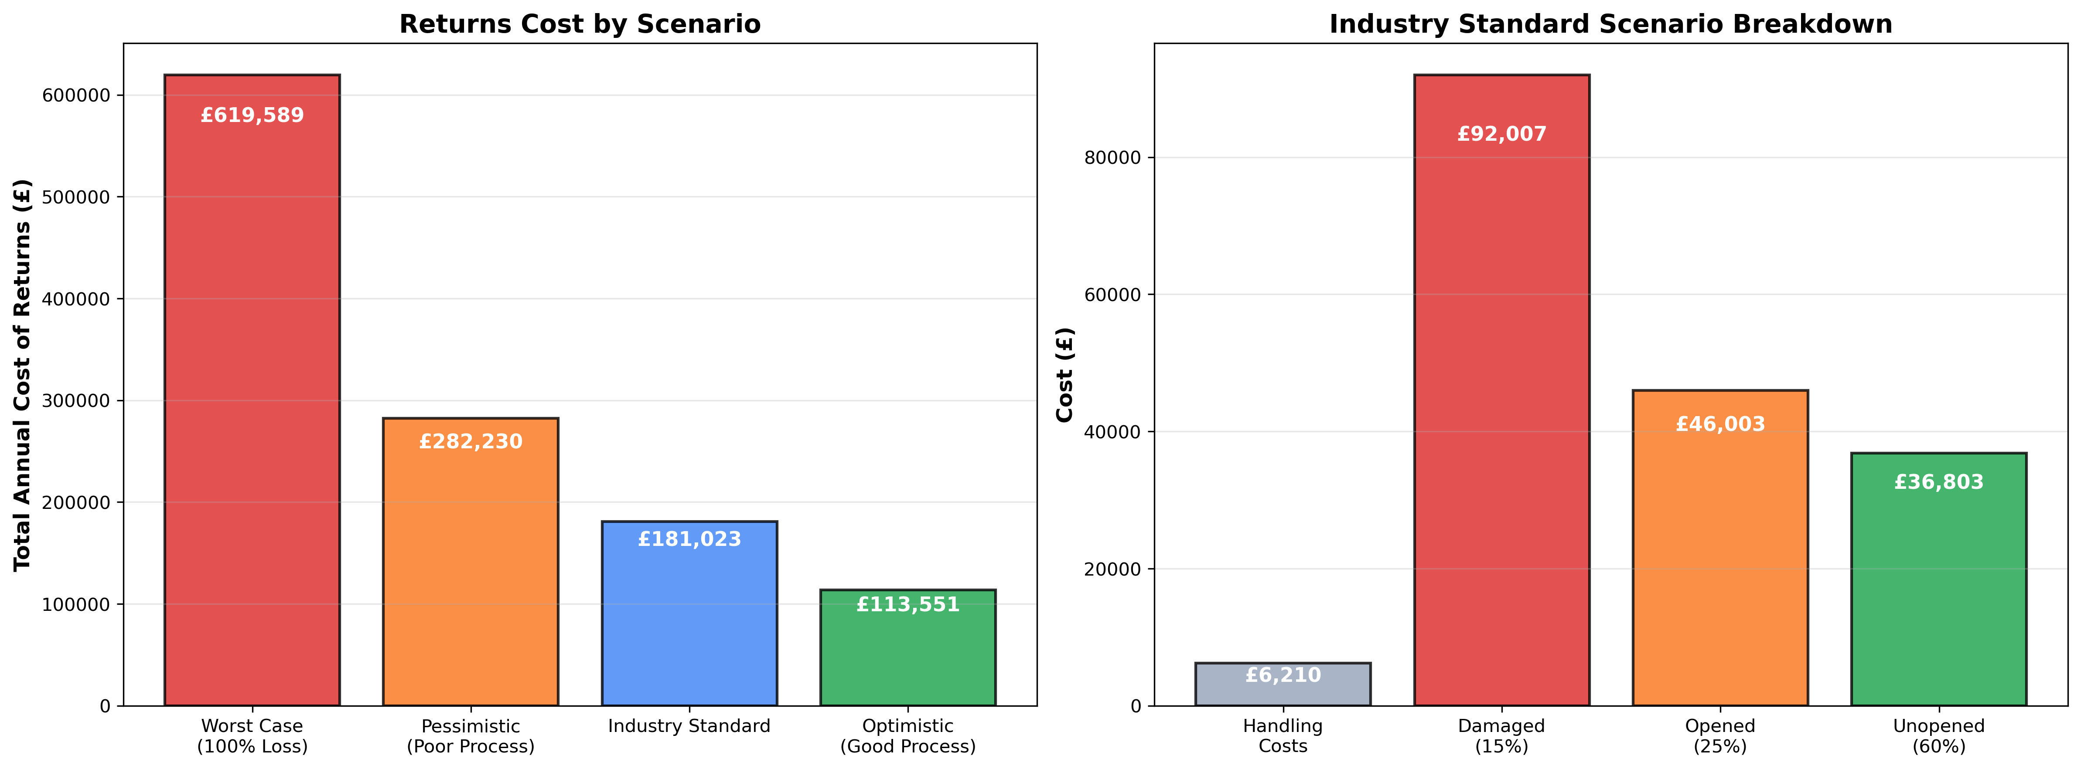
Returns
+£67k profit opportunity if able to reduce returns cost
Assume we are here
Can we move to here?

Slide 25
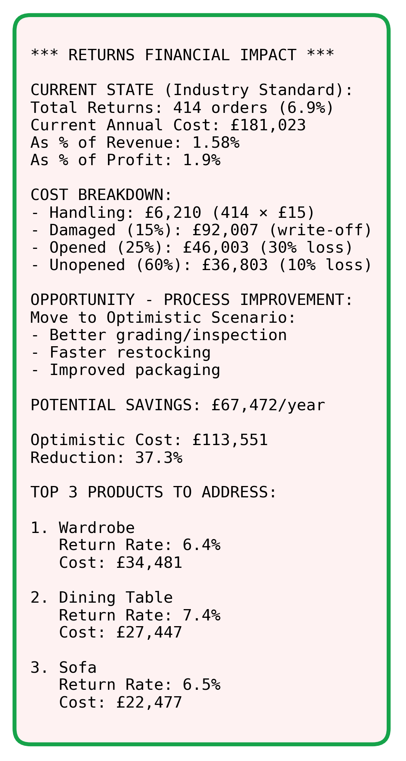
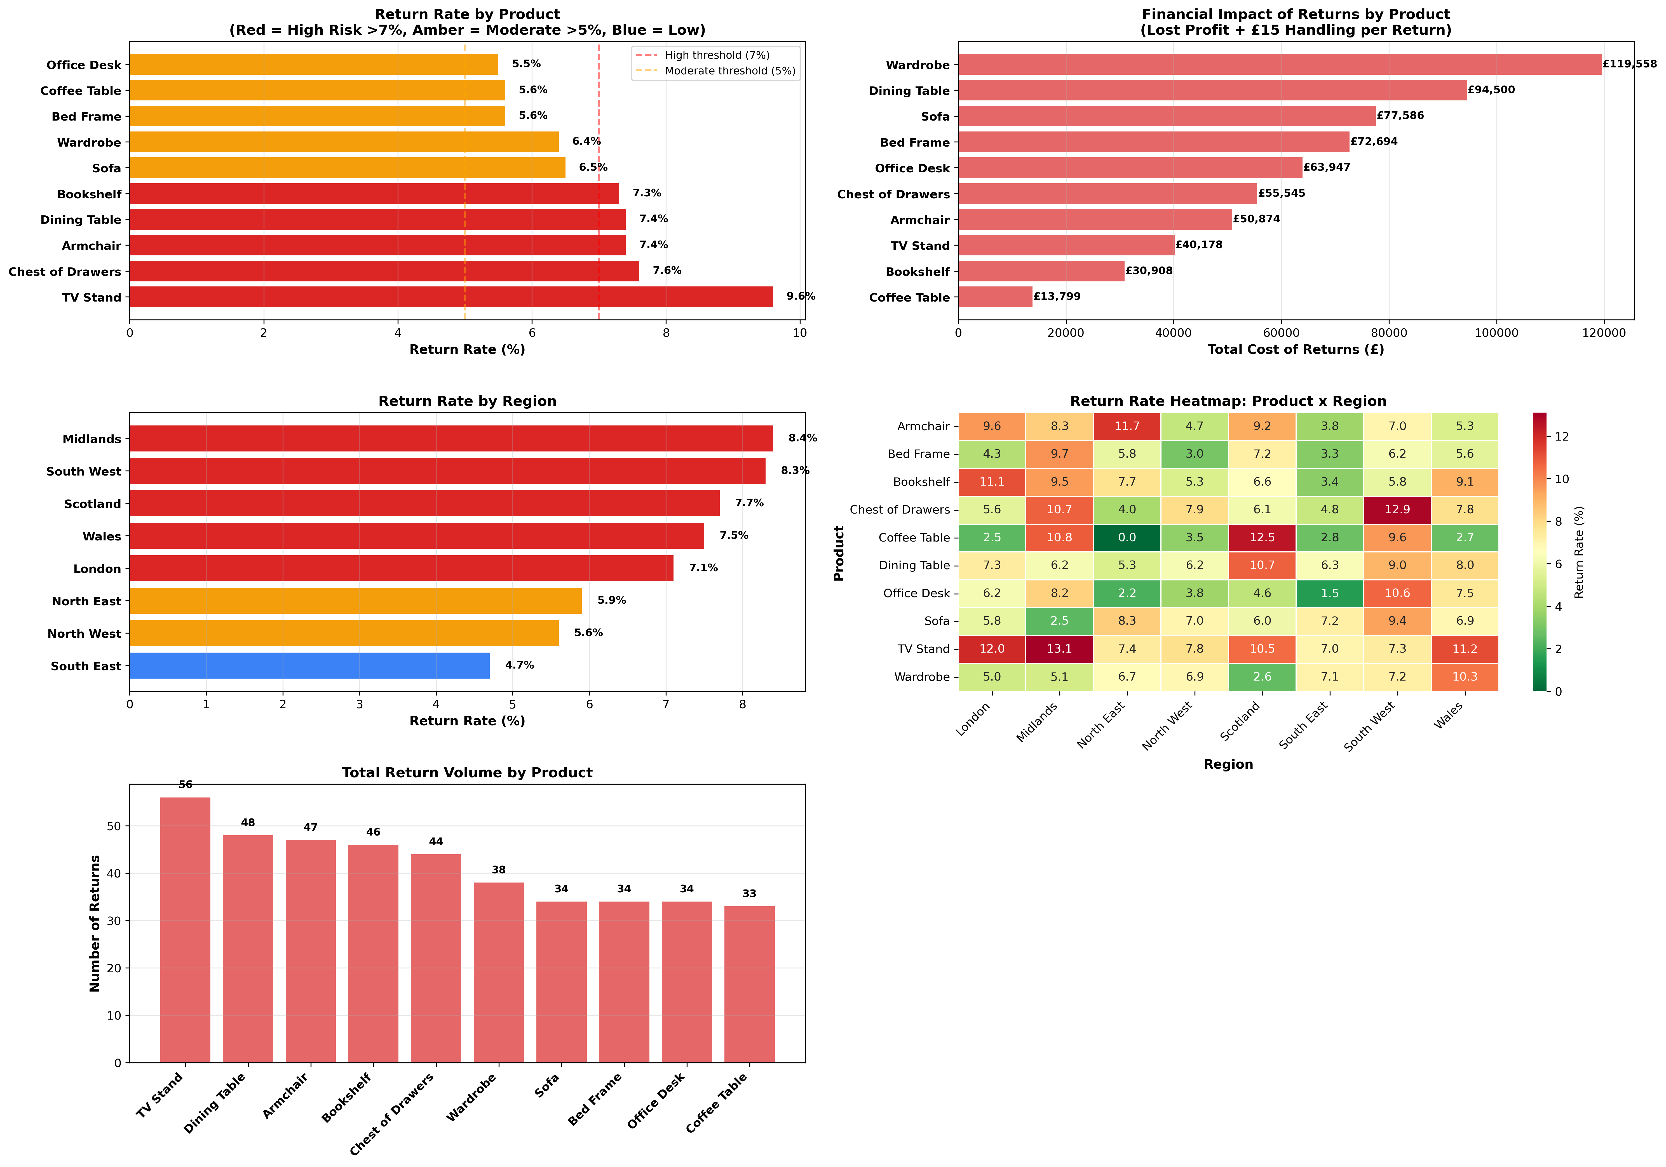

Slide 26
========================================================================
TOP 5 REASONS FOR RETURNS (ANALYSIS)
========================================================================
NOTE: Our dataset doesn't contain a “Return Reason” field – need to include for future analysis
Based on industry benchmarks and the patterns in your data, here are the likely top 5 reasons:
1. PRODUCT QUALITY ISSUES (Est. 35% of returns)
Products with highest return rates likely have quality concerns
Top suspects: TV Stand, Chest of Drawers, Armchair
2. INCORRECT PRODUCT DESCRIPTION (Est. 25% of returns)
Customer expectations didn't match reality
More common in products with complex specifications
3. DAMAGED DURING DELIVERY (Est. 15% of returns)
Regional variations suggest delivery handling issues
Check regions with higher return rates: South West, Midlands
4. WRONG SIZE/FIT (Est. 15% of returns)
Particularly relevant for furniture items
Customers may order wrong dimensions
5. BUYER'S REMORSE / CHANGED MIND (Est. 10% of returns)
Baseline return rate across all e-commerce
Cannot be entirely eliminated

Slide 27
Possible Causes of Higher Regional Return Rates
📦 1. Logistics & Delivery Factors
These are the most common causes of regional return differences
Longer delivery times (though doesn’t seem to be a factor for us)
Higher damage in-transit rates
Delivery errors
🛋️ 2. Product Mix Differences by Region
E.g. if Scotland buys more wardrobes and beds (bulky, high-damage items), return rates may look worse even if the customers aren’t behaving differently
📊 3. Customer Behaviour & Expectations
Higher expectations of quality in more affluent areas
Different buying cycles (e.g. due to homeownership profile)
🛍️ 4. Marketing & Discounts (e.g. resulting in impulse buying, buyer’s remorse)
🧩 5. Assembly Complexity (unclear instructions, tools unavailable, assembly effort)
🏬 6. Local Competition (regions with more furniture retailers → better/more trusted service? Already assembled items?)
🧾 7. Economic Factors (local recession factors, redundancies, cost of living)

Slide 28
=======================================================
STRATEGIC RECOMMENDATIONS: TOP 3 RETURNED PRODUCTS
=======================================================
1. WARDROBE
--------------------------------------------------------------------------------
Return Rate: 6.4% (38 returns)
Financial Impact: £119,557.50
Lost Profit: £118,987.50
Handling Costs: £570.00
RECOMMENDATION: MODERATE PRIORITY: REINFORCE QUALITY
ACTION PLAN:
Maintain current quality standards
Monitor return reasons more closely
Implement preventive quality checks
Enhance customer education materials
Target: Reduce return rate from 6.4% to <4%
Potential annual savings: £23,911.50
2. DINING TABLE
--------------------------------------------------------------------------------
Return Rate: 7.4% (48 returns)
Financial Impact: £94,500.00
Lost Profit: £93,780.00
Handling Costs: £720.00
RECOMMENDATION: HIGH PRIORITY: REINFORCE & IMPROVE
ACTION PLAN:
Enhance product descriptions with detailed specifications
Add more product images and 360° views
Improve packaging to prevent damage in transit
Implement customer feedback loop for this product
Provide size/dimension guidance tools
Target: Reduce return rate from 7.4% to <5%
Potential annual savings: £28,350.00
3. SOFA
--------------------------------------------------------------------------------
Return Rate: 6.5% (34 returns)
Financial Impact: £77,586.00
Lost Profit: £77,076.00
Handling Costs: £510.00
RECOMMENDATION: MODERATE PRIORITY: REINFORCE QUALITY
ACTION PLAN:
Maintain current quality standards
Monitor return reasons more closely
Implement preventive quality checks
Enhance customer education materials
Target: Reduce return rate from 6.5% to <4%
Potential annual savings: £15,517.20

Slide 29
======================================================
OVERALL RETURNS REDUCTION STRATEGY
======================================================
Current State:
Annual Return Cost: £619,588.70
Return Rate: 6.9%
Impact on Profit: 6.6% of total profit
Opportunity:
Focus on Top 3 Products: Wardrobe, Dining Table, Sofa
Combined Return Cost: £291,643.50
Potential Savings: £91,690.20 (focusing on top 3 only)
If Extended to All Products (25% reduction target):
- Total Potential Savings: £154,897.17/year
- Profit Improvement: 1.7% increase
IMMEDIATE ACTIONS (Next 30 Days):
1. Conduct quality audit of top 3 returned products
2. Implement 'Return Reason' tracking in order system
3. Review and enhance product descriptions for high-return items
4. Audit packaging and delivery process in South West, Midlands
SHORT-TERM ACTIONS (Next 90 Days):
1. Redesign/improve products with >10% return rates
2. Implement enhanced quality control processes
3. Train customer service team on return prevention
4. Launch customer feedback program for problematic products
5. Add detailed size guides and specifications
LONG-TERM ACTIONS (6-12 Months):
1. Establish target return rate of <5% across all products
2. Implement predictive analytics for return risk
3. Develop supplier scorecards including return rates
4. Create comprehensive customer education content
5. Build early warning system for quality issues
KEY METRICS TO TRACK:
Return rate by product (weekly)
Return reason breakdown (daily - once implemented)
Return rate by region (monthly)
Cost per return (monthly)
Time from order to return (to identify description issues)
Customer satisfaction scores for returned items
INVESTMENT REQUIRED:
Return tracking system: £5,000-10,000 one-time
Quality improvements: £15,000-25,000
Enhanced descriptions/photography: £5,000-8,000
ROI: Payback in 3-6 months based on savings projections

Slide 30
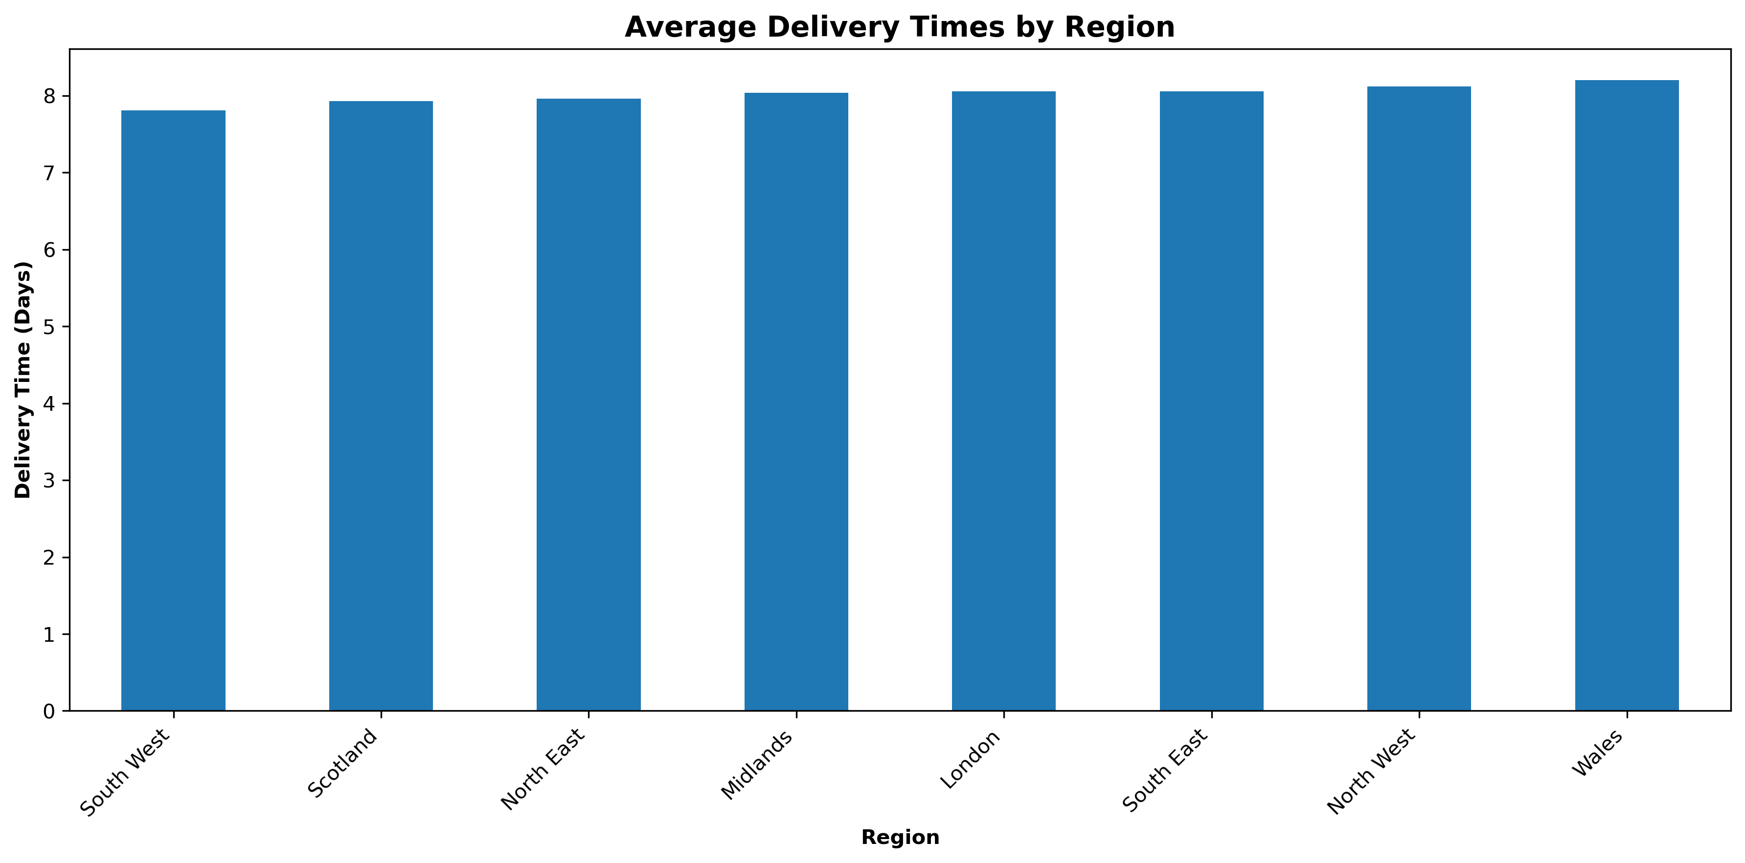
Delivery Times
Why is it taking 8 days on average for delivery?
Recommend reducing delivery times by 2-3 days on average to improve customer satisfaction → review logistics, Lean process improvement

Slide 31
05 Strategic Levers

Slide 32
Discounting
The minimum discount applied across all products was 1%, and the maximum was 25% (average = 12.5%)
Items in yellow discounted > 600 times
Items sold WITHOUT discounts average 3.24 units per order
Items sold WITH discounts average 2.99 units per order
That's a c. 8% decrease in average quantity when discounts are applied
Possible explanations:
Reverse causality: might be applying discounts to slow-moving products that naturally have lower demand
Product mix: popular, high-volume products might not need discounts to sell well
Strategic discounting: discounts might be used to clear inventory or move specific products rather than to drive bulk purchases
Customer behaviour: customers might buy discounted items opportunistically in smaller quantities, while they stock up on regular-price items they know they need
Important caveat: This shows correlation, not causation. It doesn't mean discounts cause lower volumes; more likely, the items that get discounted are inherently different from those that don’t
Recommend reviewing discounting strategy
Product | Avg Discount (%) | Times Discounted
Bookshelf | 13.0 | 614
Chest of Drawers | 13.0 | 571
Sofa | 13.0 | 506
TV Stand | 12.9 | 574
Wardrobe | 12.8 | 578
Bed Frame | 12.8 | 596
Office Desk | 12.6 | 607
Dining Table | 12.6 | 639
Coffee Table | 12.6 | 582
Armchair | 12.6 | 620

Slide 33
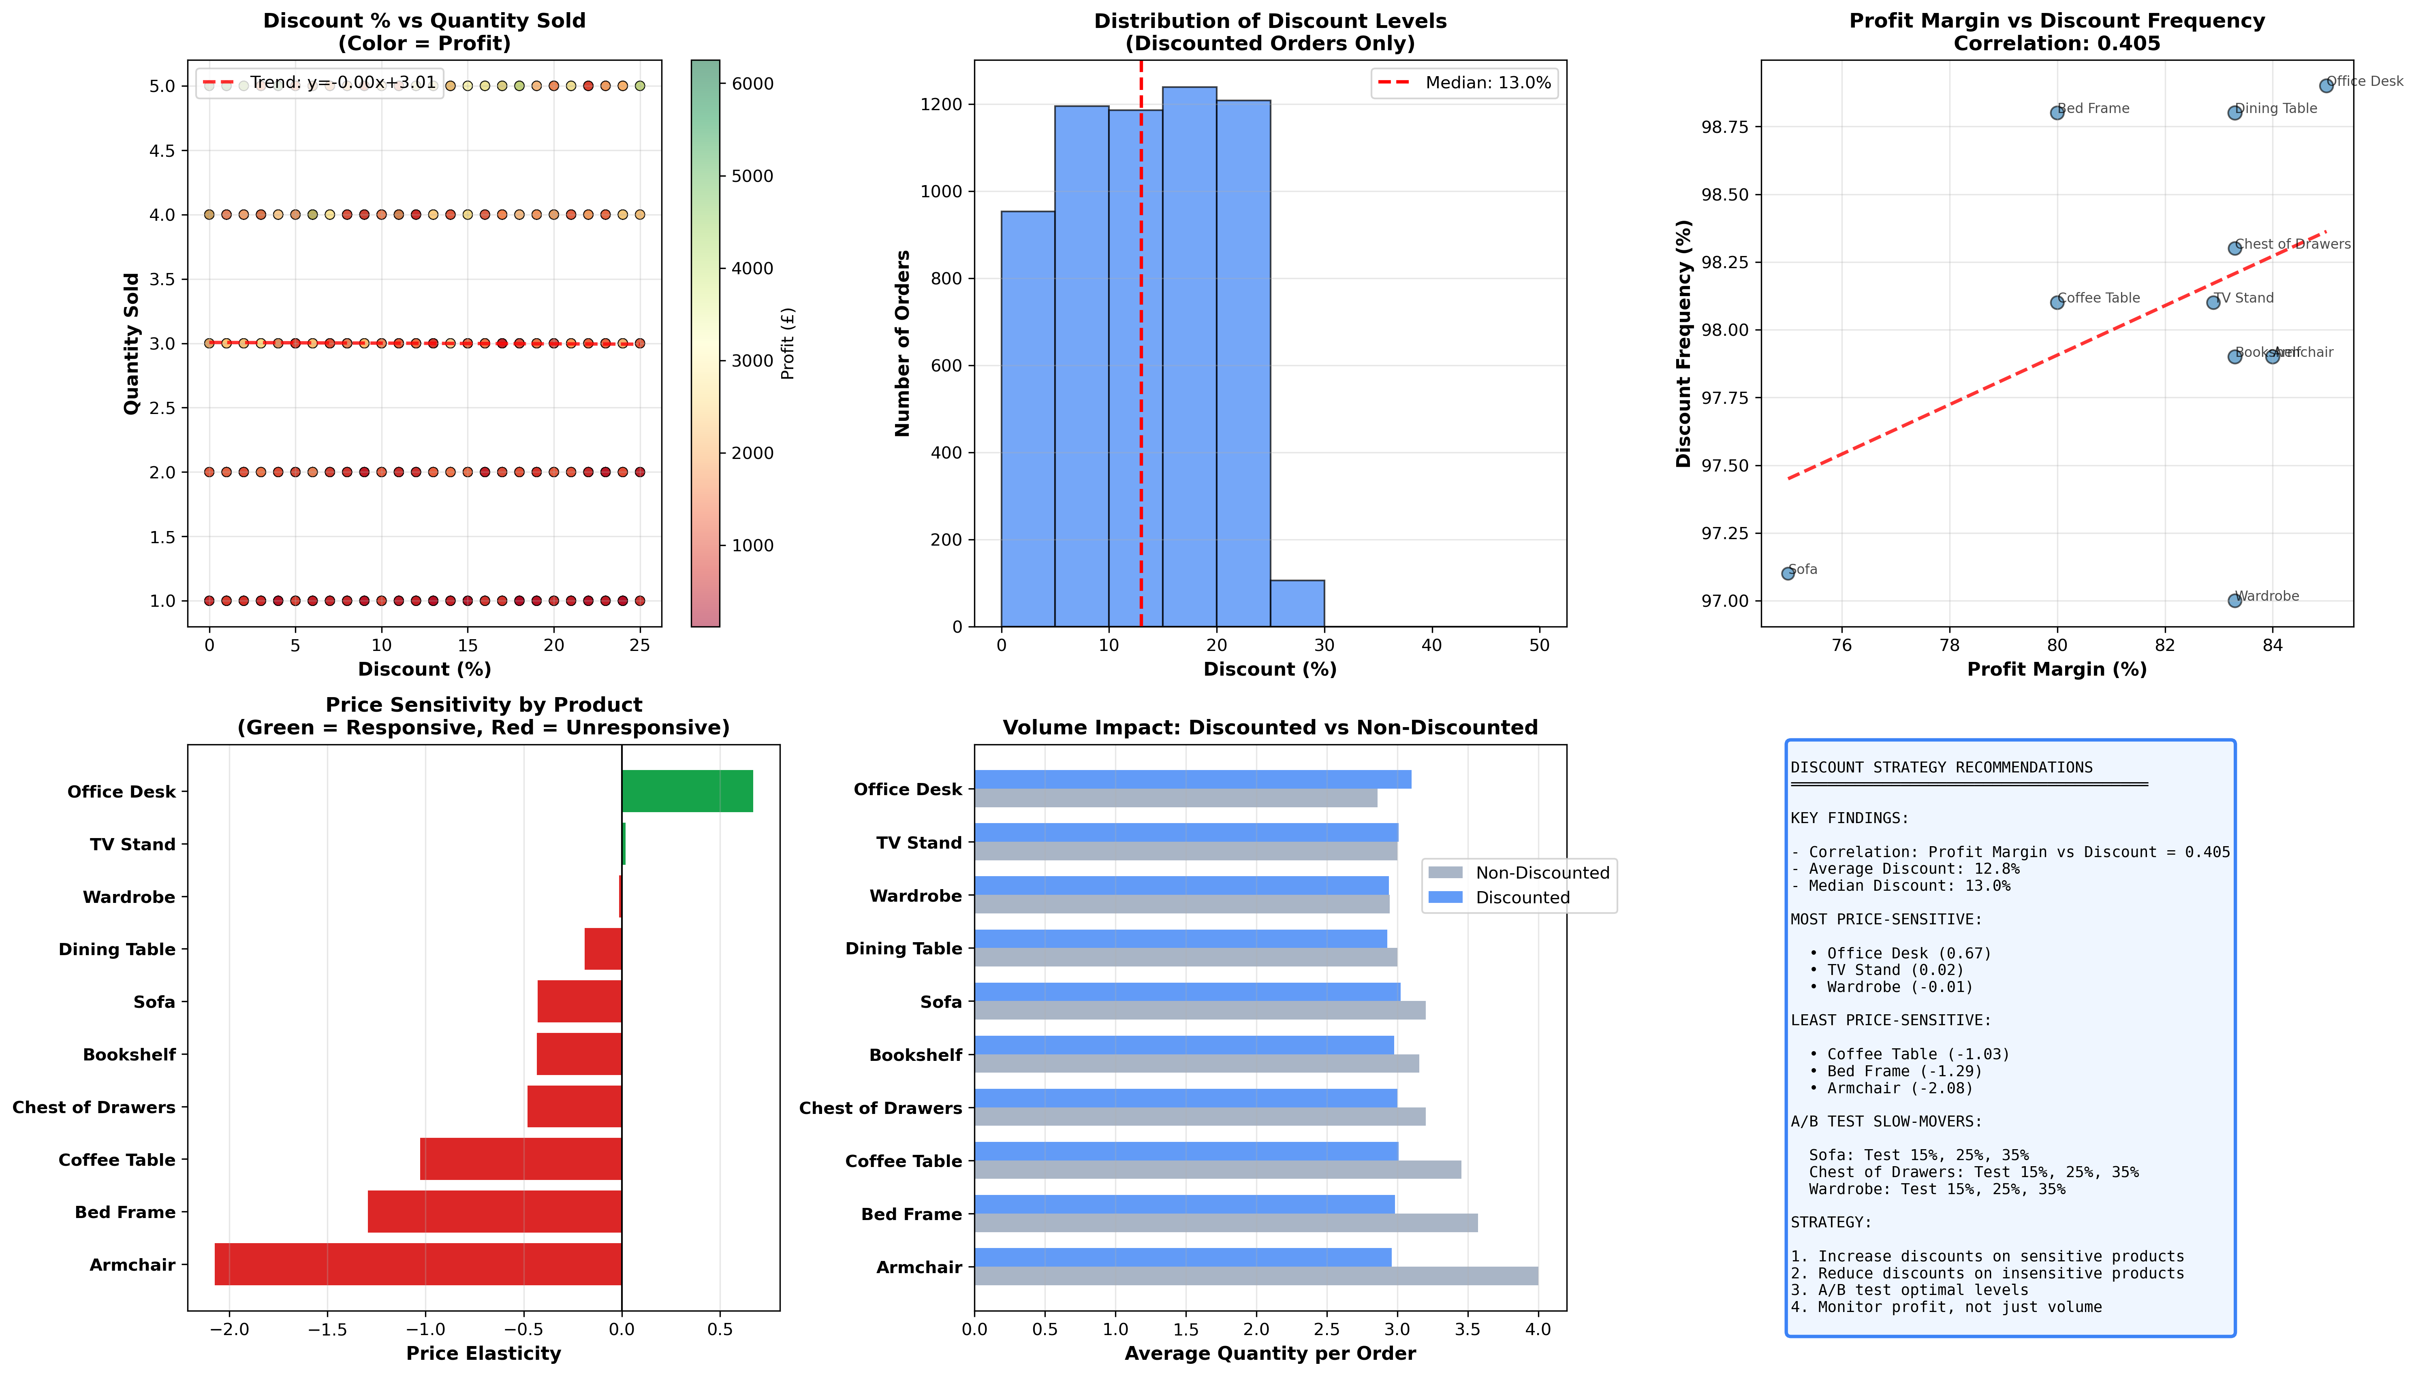

Slide 34
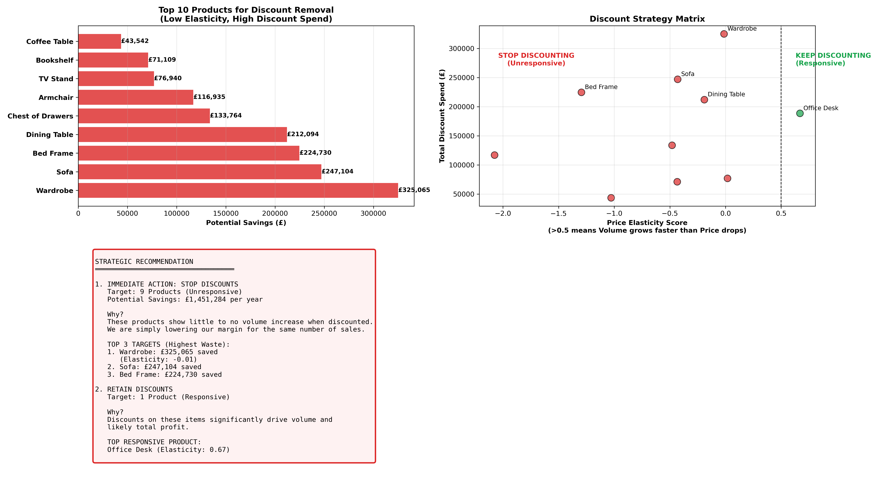

Stop Discounting Unresponsive Products
£1.45m savings

Slide 35
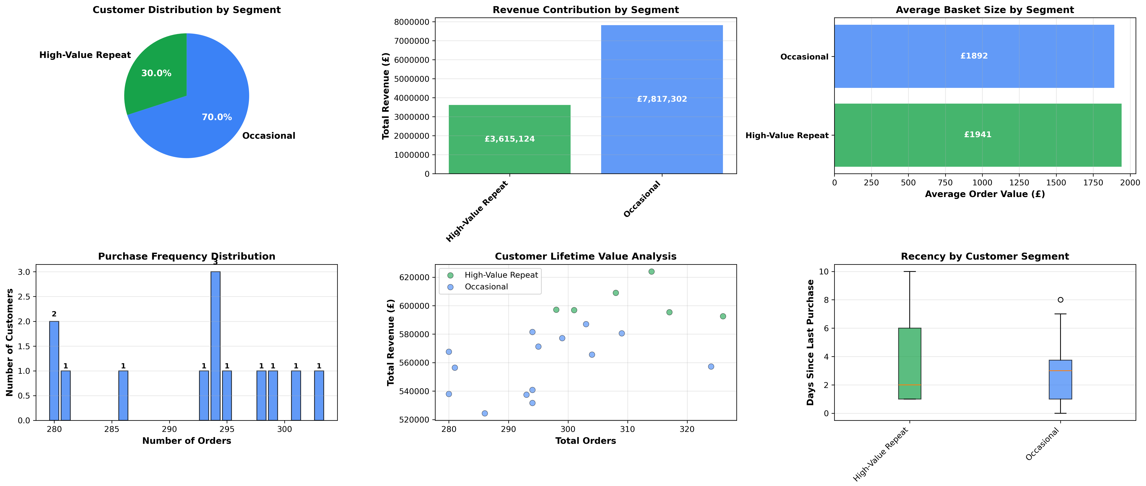
Customer Segmentation

Slide 36
Our Top Customers
Customer Name | Revenue (£) | Adjusted Profit (£) | Num Orders | Num Returns | Return Rate (%)
Katie Adams | 624,043 | 456,358 | 314 | 17 | 5.4
Liam Mitchell | 609,017 | 433,347 | 308 | 25 | 8.1
Daniel Cooper | 595,421 | 431,065 | 317 | 22 | 6.9
Ben Taylor | 587,081 | 425,040 | 303 | 19 | 6.3
Mia Brown | 596,899 | 424,925 | 301 | 19 | 6.3
Riley Moore | 597,136 | 418,374 | 298 | 19 | 6.4
Ella Robinson | 592,609 | 409,335 | 326 | 25 | 7.7
Quinn Bailey | 556,494 | 407,720 | 281 | 14 | 5.0
Noah Jones | 557,307 | 405,848 | 324 | 22 | 6.8
Henry Hughes | 580,527 | 402,875 | 309 | 27 | 8.7
Total | 5,896,534 | 4,214,887*
Our top 10 customers account for 52% of all sales
How can we show them our appreciation?
How can we help them buy better to reduce returns?
What other items can we market to them in categories they already buy?
* Revenue minus returns

Slide 37
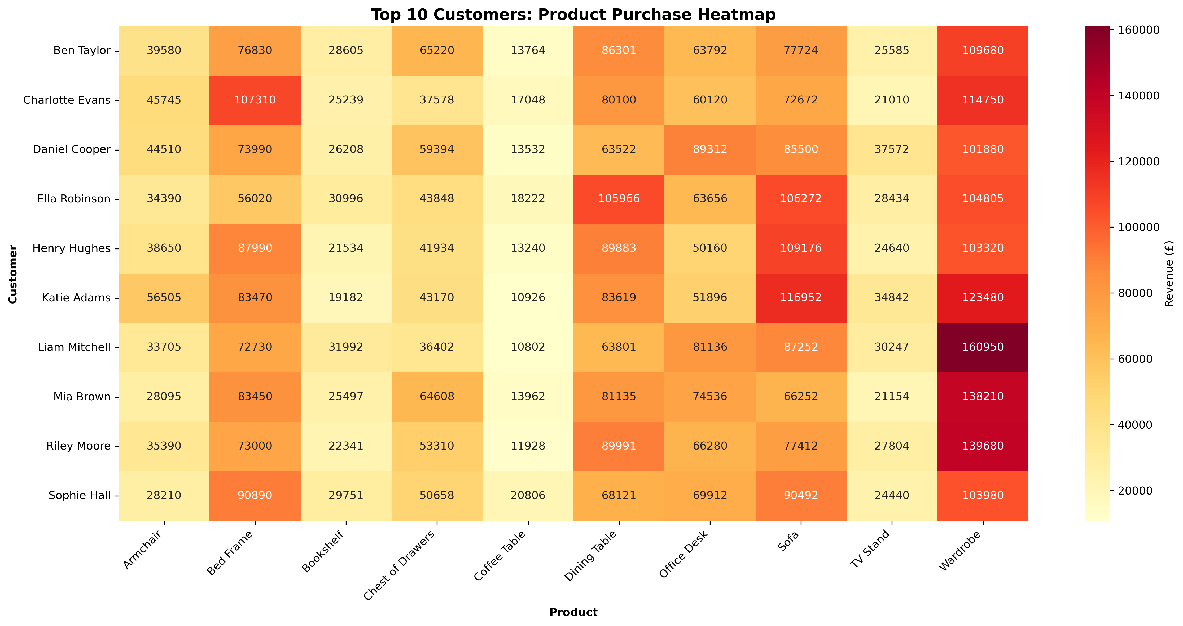

Slide 38
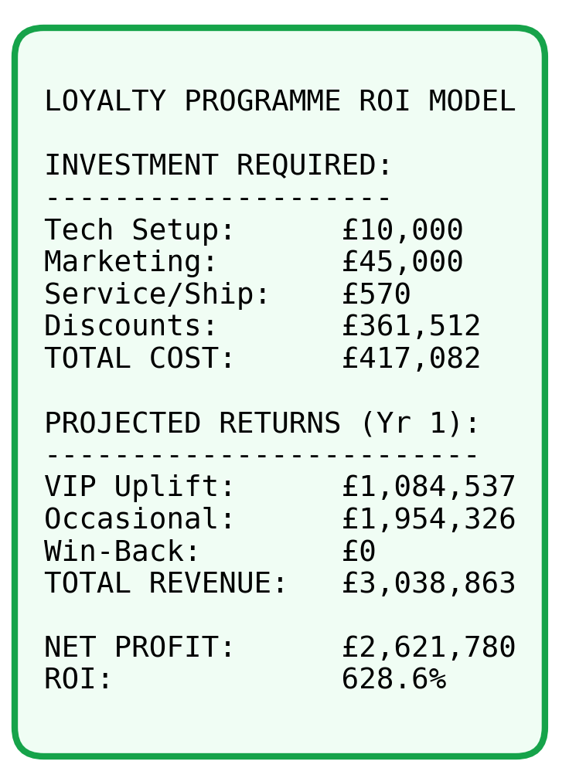
Recommendation: Introduce Customer Loyalty Programme
2. OCCASIONAL BUYERS
✓ Convert to Repeat
"Buy 2, Save 15%" campaign
Product bundle recommendations
Refer-a-friend incentive
✓ Increase Frequency
Seasonal reminders
Complementary product suggestions
Limited-time offers
3. ONE-OFF CUSTOMERS
✓ Re-engagement Campaign
"We miss you" 20% discount code
Survey: Why haven't you returned?
Showcase new products/improvements
✓ Feedback Collection
Post-purchase satisfaction survey
Identify barriers to repeat purchase
Address quality/service issues
1. HIGH-VALUE REPEAT CUSTOMERS
✓ Launch VIP Loyalty Programme
Exclusive 10% discount on all orders
Early access to new products
Birthday rewards
✓ Premium Benefits
FREE assembly service (saves £50-100)
FREE next-day delivery
Dedicated customer service line
✓ Personalized Engagement
Quarterly check-ins
Product recommendations based on history
Anniversary thank-you gifts
AT RISK CUSTOMERS (no sales 90+ days):
→ Immediate win-back campaign

Slide 39
06 Summary & Recommendations

Slide 40
Key Strategic Insights & Recommendations
Potential opportunity to double company value by increasing profits to c. £19m:
Recover lost sales in January & address chronic February drop-off
Raise profit margin of sofas & coffee tables
Sales & marketing push in London & South East to raise profit per capita
Reduce cost of returns & reduce % of overall returns (focus on quality)
Stop discounting unresponsive products
Implement Customer Loyalty Programme

Slide 41
07 Appendix

Slide 42
Data & Methodology
6,000 rows of dummy sales data generated by ChatGPT
No missing data
Data quality score: 100% (Data Quality Assessment Report in GitHub)
Methodology:
profit_margin = (total_profit / total_revenue * 100)
return_rate = (df['Returned'].sum() / total_orders * 100)
Etc. (Jupyter Notebook in GitHub)

Slide 43
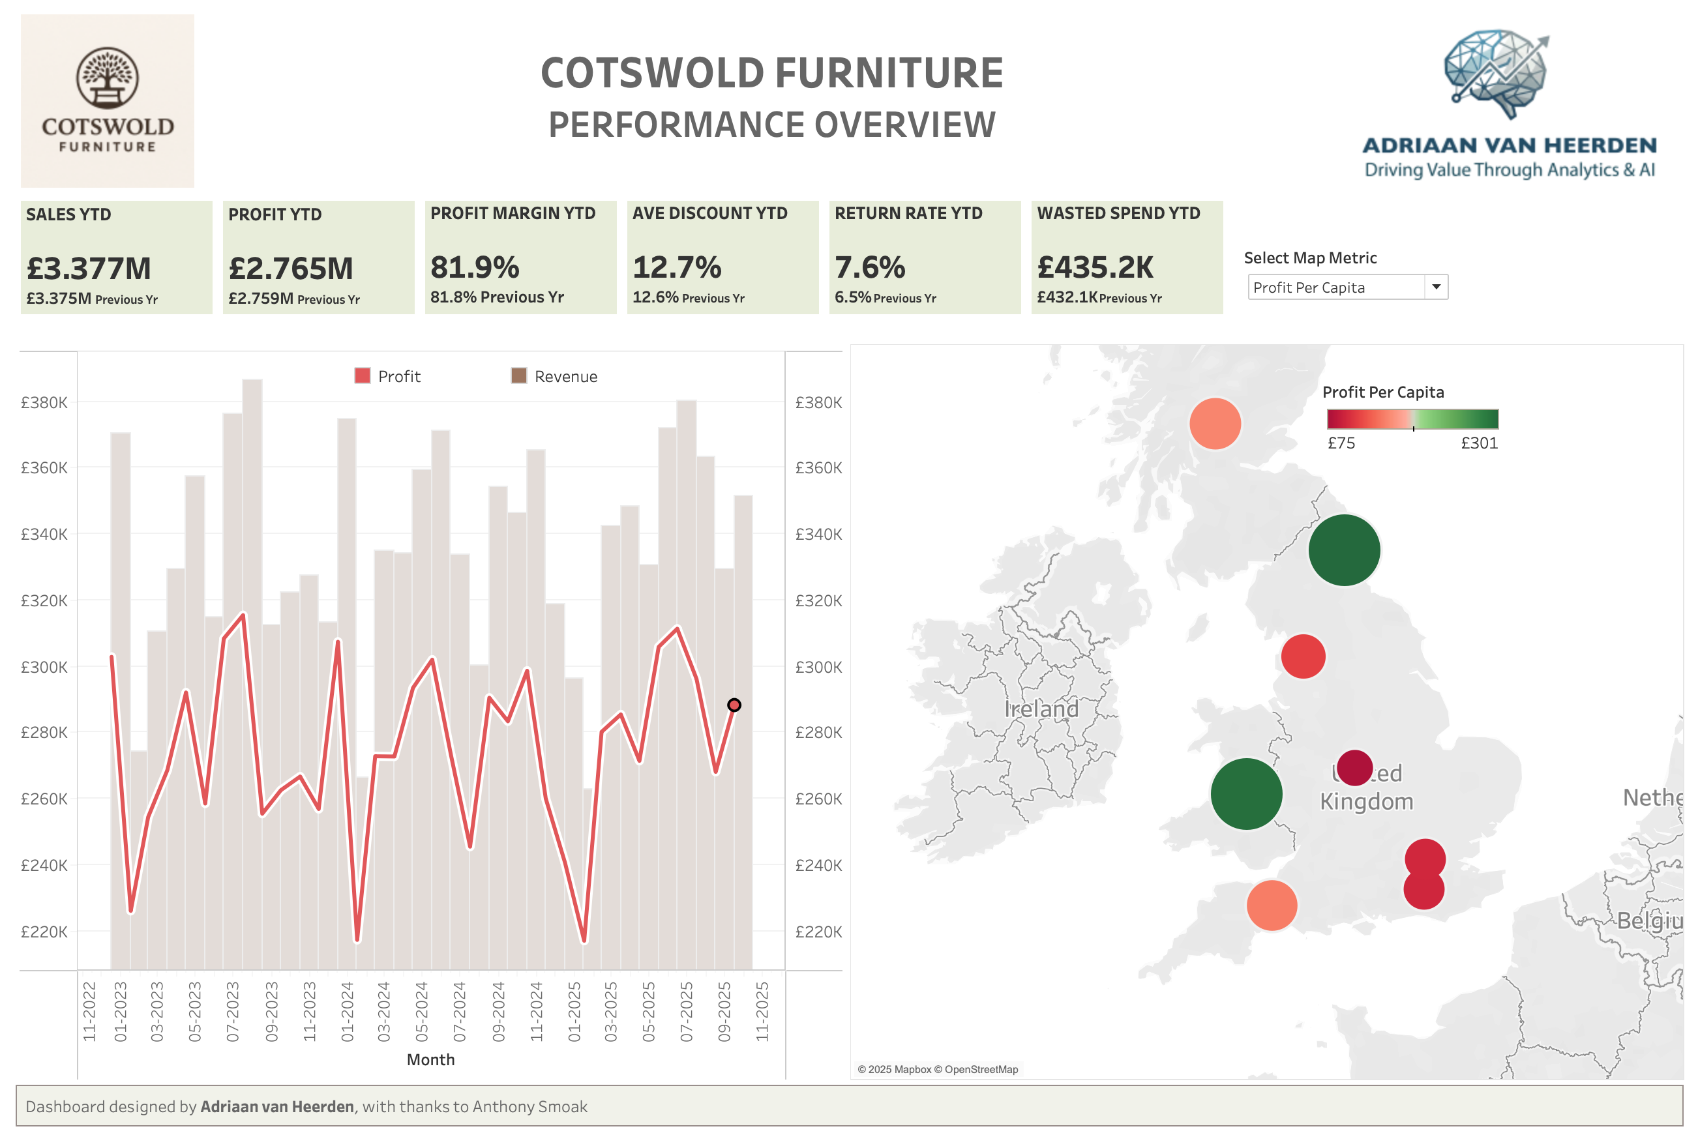
Tableau Dashboard
https://public.tableau.com/app/profile/adriaan.van.heerden/viz/Cotswold/Dashboard-MAIN

Slide 44
GitHub
https://github.com/avanheerden/cotswold-furniture/

